Slide 1
Advanced Spec Flow topics
BY
Kirubanand ramasamy

Slide 2
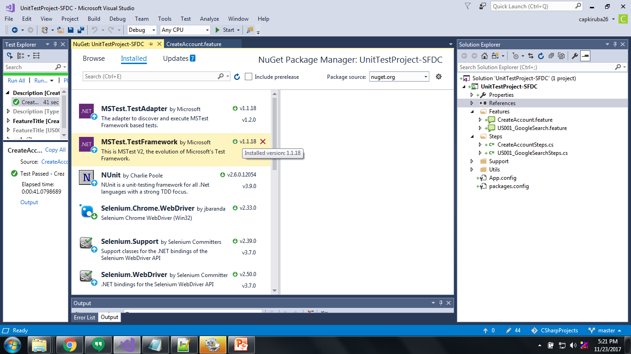

Slide 3
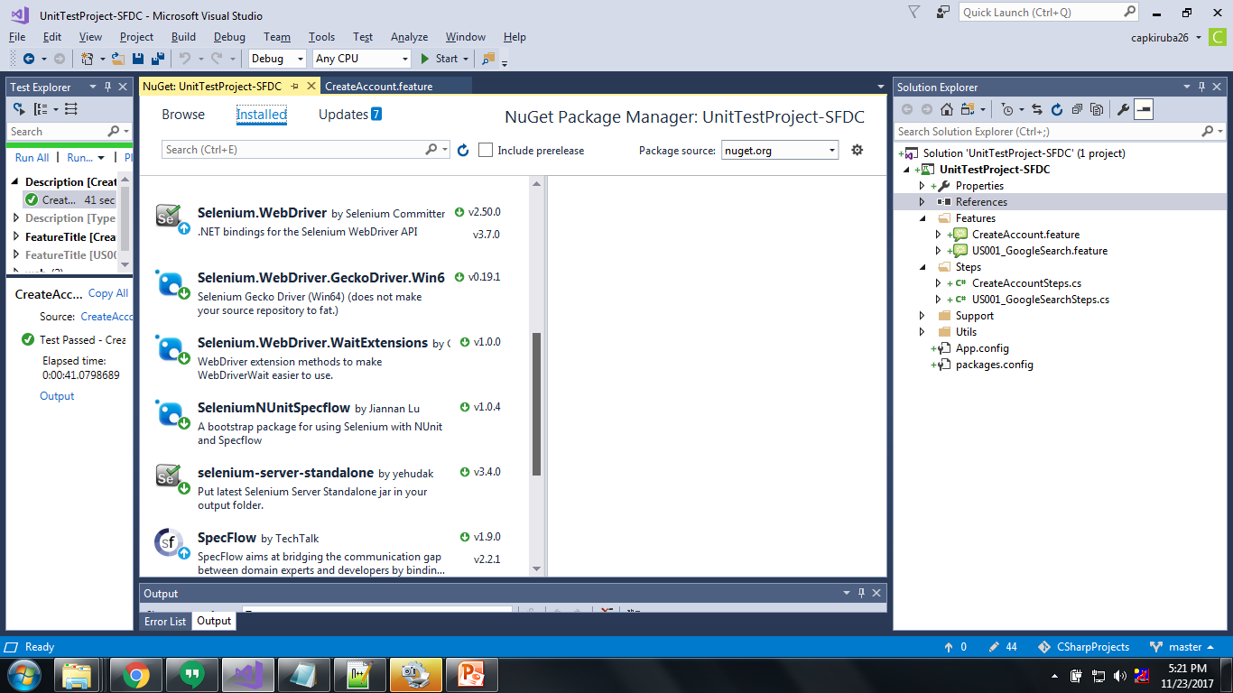

Slide 4
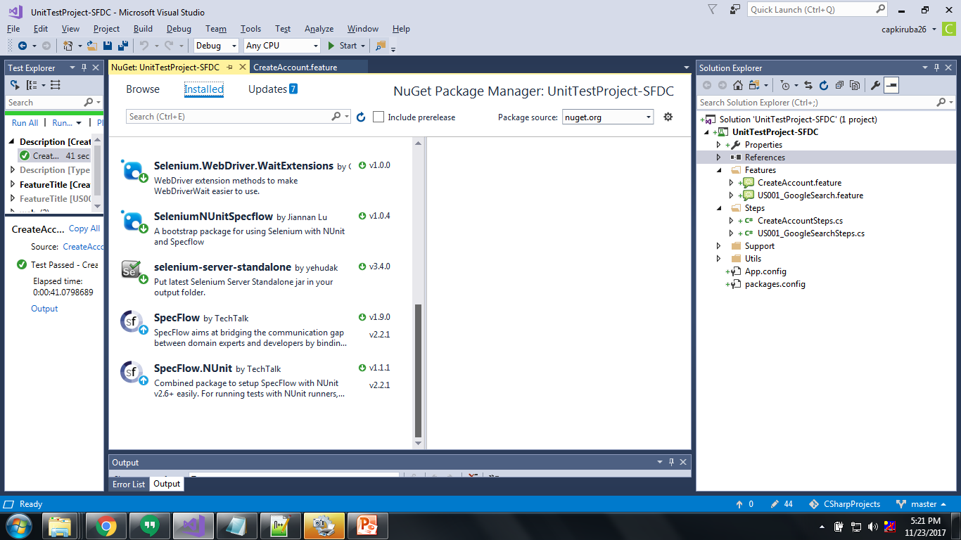

Slide 5
https://automatetheplanet.com/extend-test-execution-workflow-specflow-hooks/.
https://www.nuget.org/packages/SpecRun.SpecFlow
https://automatetheplanet.com/extend-test-execution-workflow-specflow-hooks/

Slide 6
If we want to generate specflow.spec run
<?xml version="1.0" encoding="utf-8"?>
<configuration>
<configSections>
<section name="specFlow" type="TechTalk.SpecFlow.Configuration.ConfigurationSectionHandler, TechTalk.SpecFlow" />
</configSections>
<appSettings>
<add key="AppUrl" value="https://test.salesforce.com/" />
</appSettings><specFlow>
<!-- For additional details on SpecFlow configuration options see http://go.specflow.org/doc-config -->
<!-- use unit test provider SpecRun+NUnit or SpecRun+MsTest for being able to execute the tests with SpecRun and another provider -->
<unitTestProvider name="SpecRun" />
<plugins>
<add name="SpecRun" />
</plugins>
</specFlow></configuration>
Notes:
https://www.nuget.org/packages/SpecRun.SpecFlow#

Slide 7
If we want report test report.spec flow
<?xml version="1.0" encoding="utf-8"?>
<configuration>
<configSections>
<section name="specFlow" type="TechTalk.SpecFlow.Configuration.ConfigurationSectionHandler, TechTalk.SpecFlow" />
</configSections>
<specFlow>
<!-- For additional details on SpecFlow configuration options see http://go.specflow.org/doc-config -->
<!-- For additional details on SpecFlow configuration options see http://go.specflow.org/doc-config --><unitTestProvider name="MsTest" /><!-- For additional details on SpecFlow configuration options see http://go.specflow.org/doc-config --><stepAssemblies>
<stepAssembly assembly="TestReport.SpecFlow" />
</stepAssemblies></specFlow>
<appSettings>
<!--Report Email settings--><add key="AppUrl" value="https://test.salesforce.com/" />
<add key="testResultFolder" value="D:\CSharpProjects\UnitTestProject-SFDC\UnitTestProject-SFDC\TestResults" />
<add key="sendEmailReport" value="false" />
<add key="stmpHost" value="your.smpt.host" />
<add key="stmpPort" value="587OrElse" />
<add key="stmpSSL" value="trueOrFault" />
<add key="stmpUser" value="user" />
<add key="stmpPass" value="password" />
<add key="stmpFrom" value="anyName@your.domain" />
<add key="stmpTo" value="anyone@your.domain;anyGroup@your.domain" /></appSettings>
</configuration>
Notes:
https://github.com/myuzhang/TestReport.Net

